Slide 1
Introduction to Deep Learning
Jin Lu – UMDearborn

Slide 2
Goal of the class
Overview
When and where to use DL
"How" it works
Frontiers of DL

Slide 3
Goal of the class
Overview
When and where to use DL
"How" it works
Frontiers of DL
Arcanes of DL
Implement using Numpy, and Tensorflow (Keras)
Engineering knowledge for building and training DL
Notes:
Artificial Intelligence encompasses:
Machine Learning encompasses:
Deep learning
Python: easy to learn and write, but hard to debug (major drawback).
Use Kera library which is a smaller version of Tensorflow; use TensorFlow or Pytorch for fully optimizable model.

Slide 4
What is Deep Learning
Good old Neural Networks, with more layers/modules
Notes:
Developed 1980s-90s
Originally branded Neural Network
Rebranded as Deep Learning
Revival of Deep Learning in 2006-2007 from paper published by Hinton, Banjo and Lecum
Big 3 names in Deep Learning

Slide 5
What is Deep Learning
Good old Neural Networks, with more layers/modules
Non-linear, hierarchical, abstract representations of data
Notes:
Shallow learning models: SVM, Boosting, and Linear Regression (LR) → not as powerful.
Our previous hardware could not accommodate very complex models; today, our hardware is no longer limiting our complexity of models hence we now have nonlinear models for neural networks (now we can have nonlinear nodes in the neural network).
Key idea of neural network: filter out noise in data to amplify features that can be found in the data.

Slide 6
What is Deep Learning
Good old Neural Networks, with more layers/modules
Non-linear, hierarchical, abstract representations of data
Flexible models with any input/output type and size
Notes:
Representations of data that are of mid to large scale data sizes.
Deep learning requires relatively large sample of data.

Slide 7
What is Deep Learning
Good old Neural Networks, with more layers/modules
Non-linear, hierarchical, abstract representations of data
Flexible models with any input/output type and size
Differentiable Functional Programming
Notes:
Differentiable Functional Programming: prerequisite for deep learning model to work → model itself should be differentiable (can be broken down/segmented)
Example: a function that must be differentiable → can you calculate the gradient (slope, i.e. rate of change!) → can you find f’ for f?
If function is not directly differentiable, thus we use gradient descent to approximate the gradient (but some functions we may not have good approximations for).

Slide 8
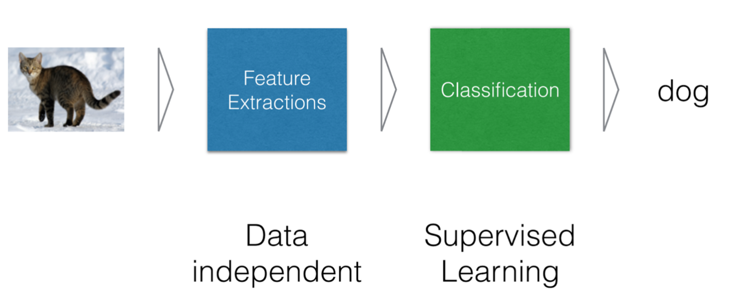
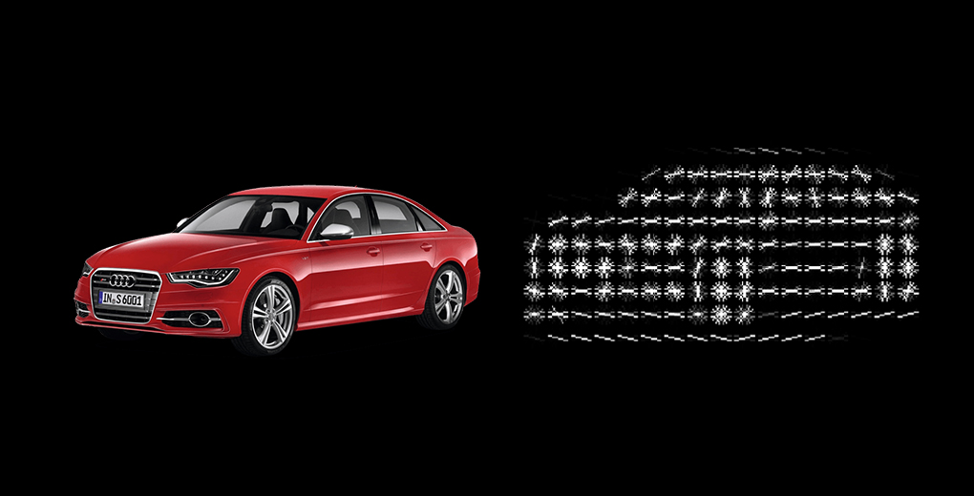
Typical ML system
Good old Neural Networks, with more layers/modules
Notes:
2 steps: 1st extract features from samples, 2nd labeling/classification
Example of features: an 3x3 pixel RGB image has → 9 pixels and thus →27 features! (9 pixels * 3(red green or blue) = 27.
But usually the domain is too large to track every possible feature; so we need to use samples and estimation models to extract features.
HOG = Histogram of a Gradient
i.e. the red car is split into elements and then the gradient of each element (compared to all of the other elements) is calculated → a differential is calculated.
More elements = more features to extract (i.e. a 9 pixel photo, v a 30 pixel photo; or i.e. 27million pixels but you break it only into 3 million elements).
You can use these classification models for the second step: DT, SVM, RFL, BOGM, BAYESIAN

Slide 9
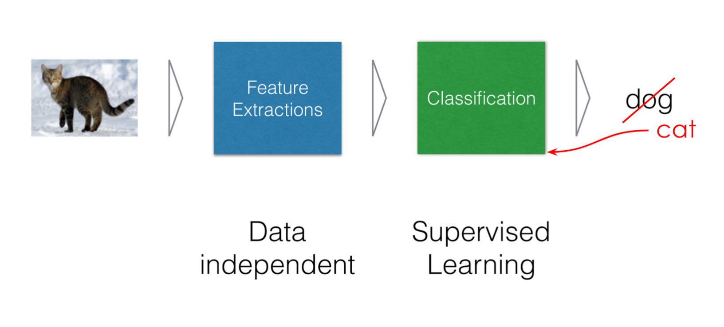
Typical ML system
Good old Neural Networks, with more layers/modules
Notes:
Untrained models may initially give incorrect output.
Models should learn from correctness and incorrectness (experience) to become more accurate: training.
Basically, just like humans can do.
Feature extraction layer may have multiple layers that are a part of that layer to build up/extract more general features as you move along the row.

Slide 10
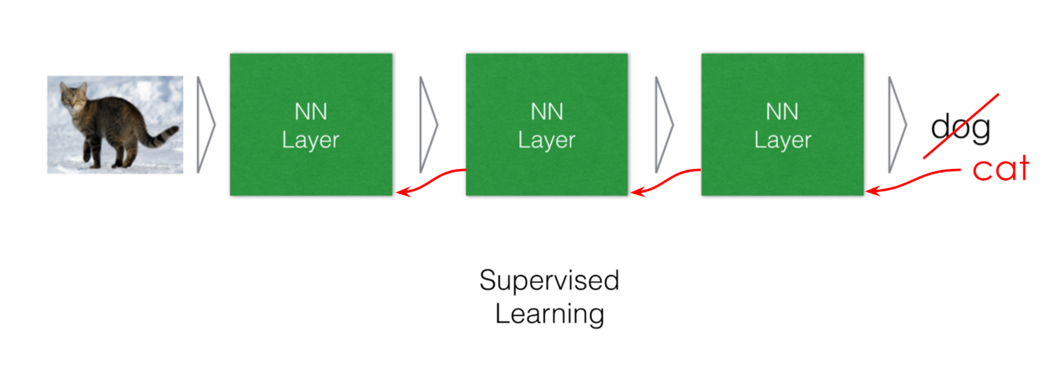
Deep Learning system
Notes:
Feature extraction layer may have multiple layers that are a part of that layer to build up/extract more general features as you move along the row.
Also: all steps are replaced by a neural network layer
For example, first 2 NN layers are Feature extraction layers, final NN is the classification layer.
Remember: assumption is that you need a lot of data → so essentially deep learning is no different than to human learning (it is stealing from how God has designed us and the animals).
You go backward to each layer during learning to make updates (back propagation).
This allows the model itself (as it is designed to do) to learn how and which features to extract.
So engineers do not need to tell the model how/which features to extract.
If 3 layers is not enough to be as effective as the previous (typical) ML system, simply add more layers.

Slide 11
Why Deep Learning Now?
Better algorithms & understanding
Computing power (GPUs, TPUs, ...)
Data with labels
Open source tools and models
Notes:
Before, we had very complex and powerful models, but not enough hardware to implement them.
i.e.Gradient descent
but → stochastic gradient descent (SGD) (much more efficient than gradient descent (GD) ); also ADAM is better than GD as well for training the model; thus we have more powerful hardware and also better (memory and/or time-saving) algorithms.

Slide 12
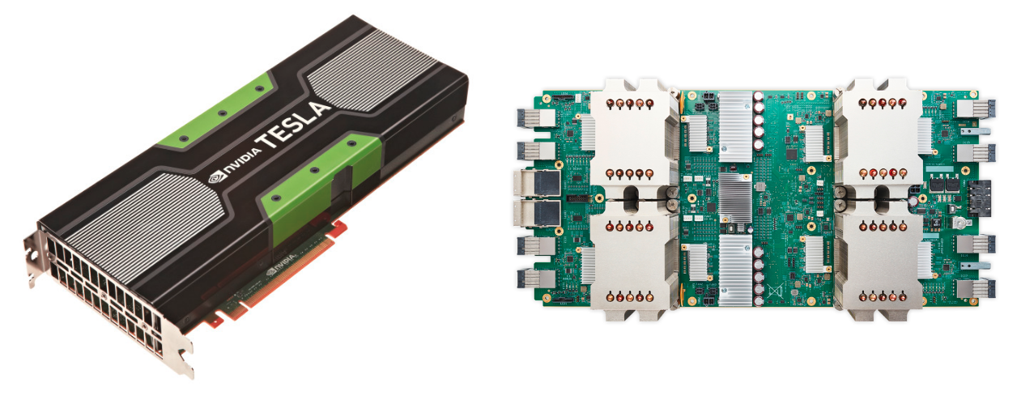
Why Deep Learning Now?
Better algorithms & understanding
Computing power (GPUs, TPUs, ...)
Data with labels
Open source tools and models
GPU and TPU
Notes:
GPU = Graphics (matrix) processing unit (handles 10ks of operations per cycle but is less accurate; CPU can only do 10s of operations per cycle but designed for high accuracy).
TPU = tensor processor unit (basically just like GPU but even more powerful → not as accurate but can handle many operations per cycle).
Powers google data centers (and has been for many years).

Slide 13
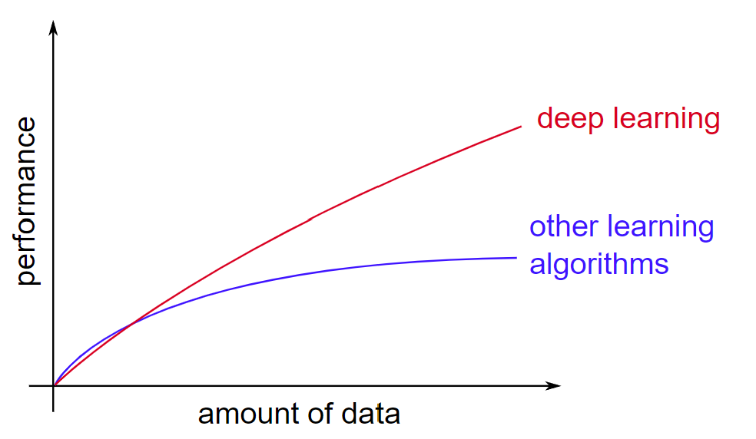
Why Deep Learning Now?
Better algorithms & understanding
Computing power (GPUs, TPUs, ...)
Data with labels
Open source tools and models
Adapted from Andrew Ng
Notes:
There is so much data out there now from the internet and the IoT → we wish to harvest it and harness it.
Quantum physics and biology: data is expensive and hard to obtain → deep learning may not show superior performance.
Other than that, deep learning generally much more powerful, but can be overkill or cause overfeeding when data sizes are limited, as shown in the graph where the red and blue lines are nearly parallel.

Slide 14
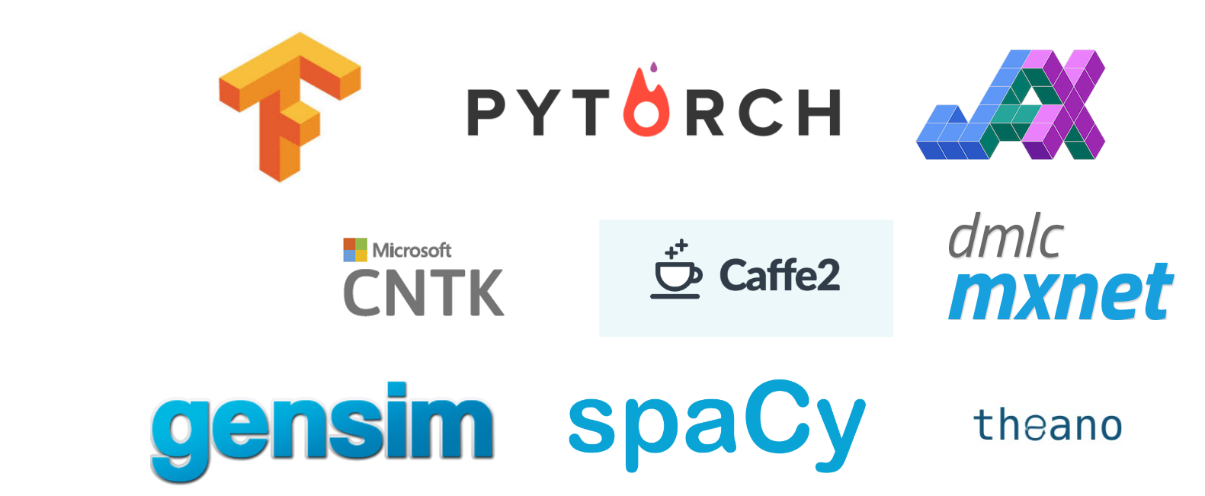
Why Deep Learning Now?
Better algorithms & understanding
Computing power (GPUs, TPUs, ...)
Data with labels
Open source tools and models
Notes:
Unlike needing Siemans equipment, or other worldclass equipment owned by large corporations or even countries (like phsyics or biology labs), the most advanced tools of the field is open source and the models developed from it is completely made public.
Field is wide open.

Slide 15
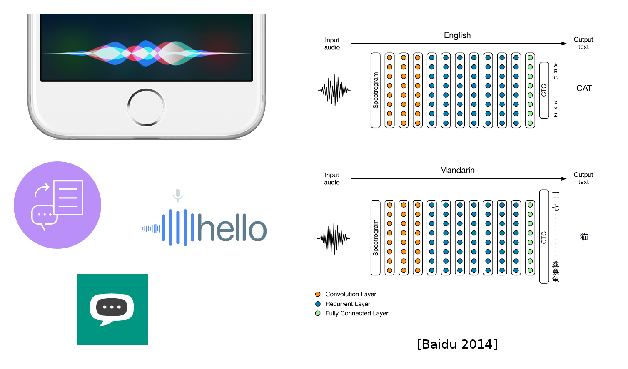
DL Today: Speech-to-Text

Slide 16
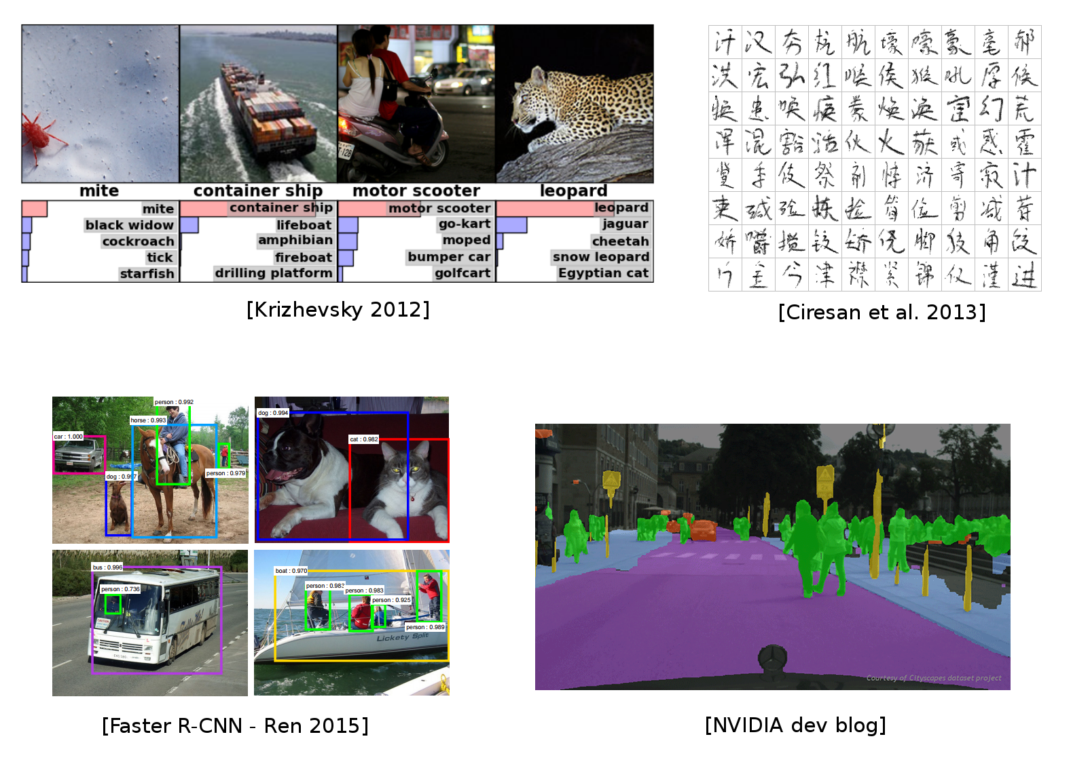
DL Today: Vision
Notes:
Deep learning relies on BIG DATA.
You can find many large big data sets to use as a baseline to train your own model you have developed.
You can use it to extract initial features and then use it for other purposes (transfer learning).
Bottom left image: more complex → need to do classification AND localization (define exactly where in the image the classification was made).

Slide 17
ASK THE PROFESSOR ABOUT PROJECT
ASK PROFESSOR IF I CAN USE MY HOME CAMERA CAR DATA SET!

Slide 18
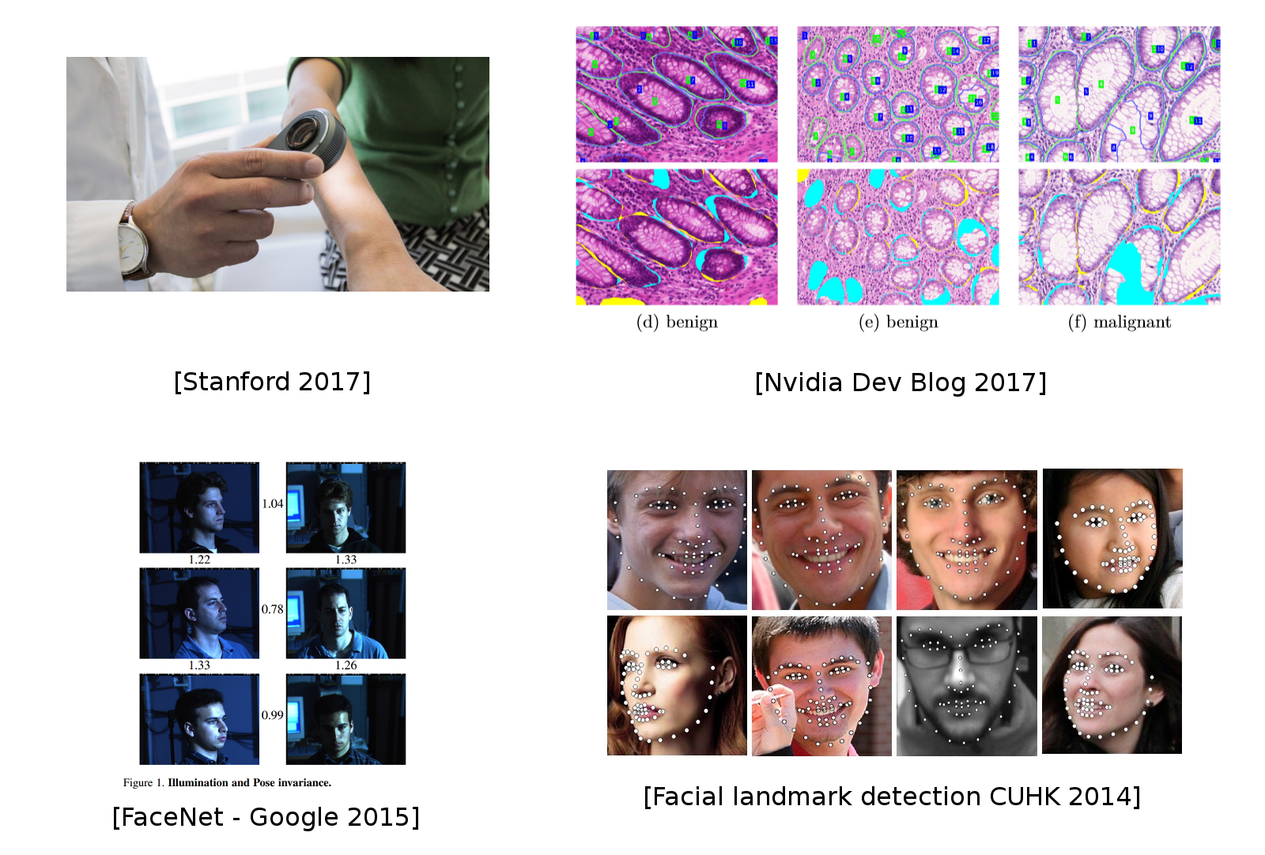
DL Today: Vision
Notes:
Can use deep learning model to predict if a skin mole is cancerous or not using large data from many patients and if they ended up having a cancer diagnoses.

Slide 19
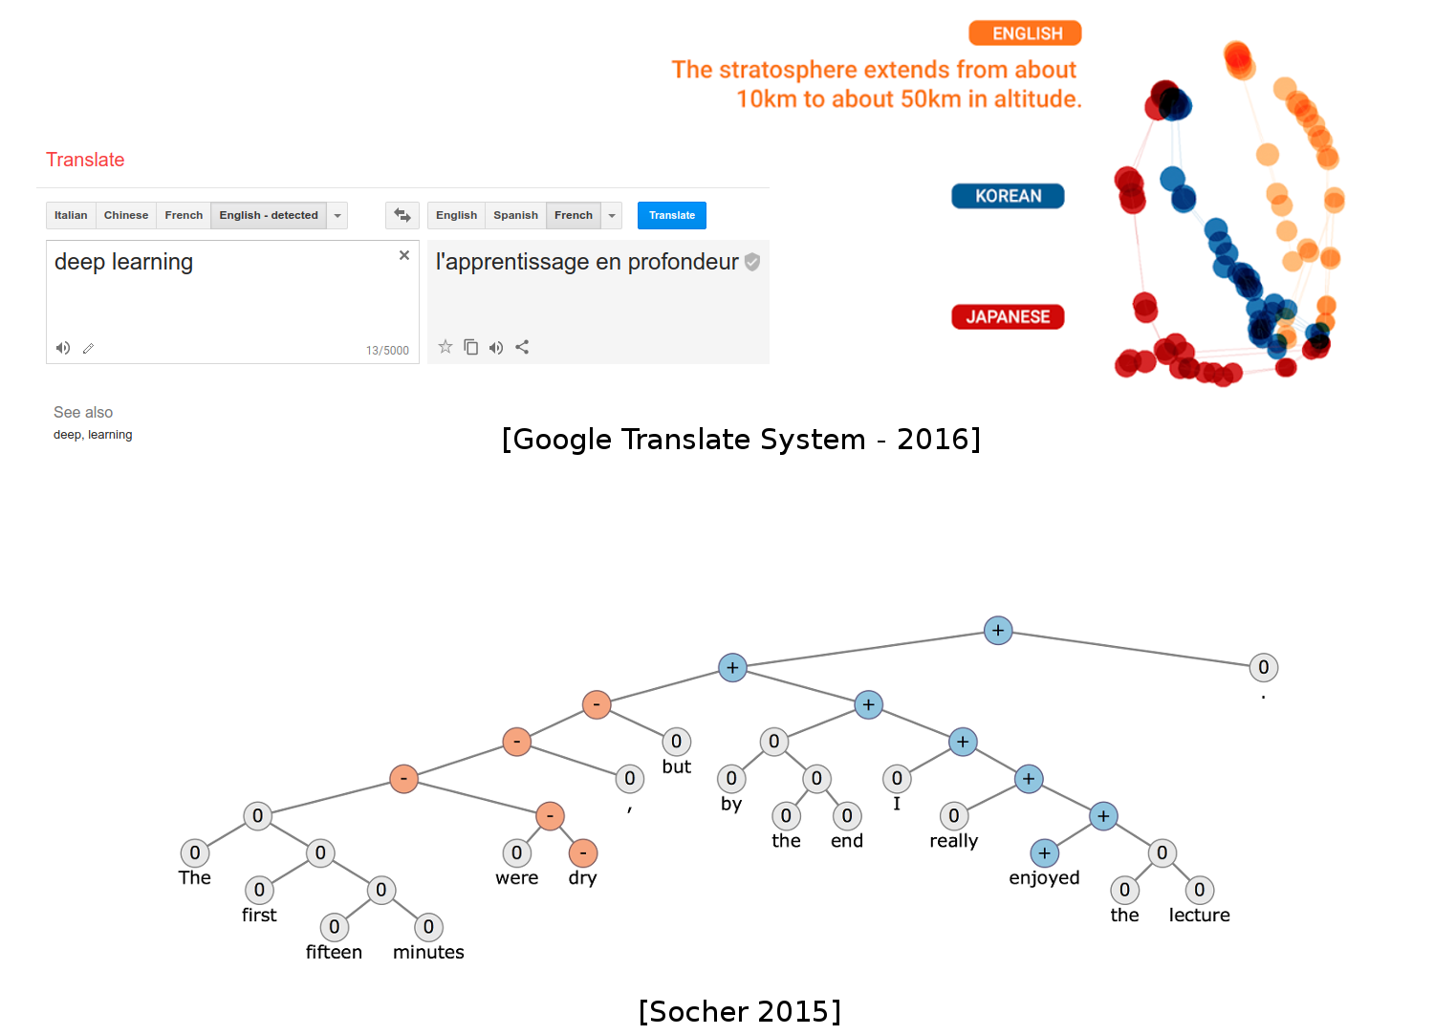
DL Today: NLP
Notes:
NLP = Natural Language Processing.
Sentiment analysis: recognize the emotional tone of each word/a sentence to see if it is a positive or negative sentence.
Also we can do pitch/sound tone analysis to predict how the sentence will sound with highs and lows like how a human talks (not monotone).

Slide 20
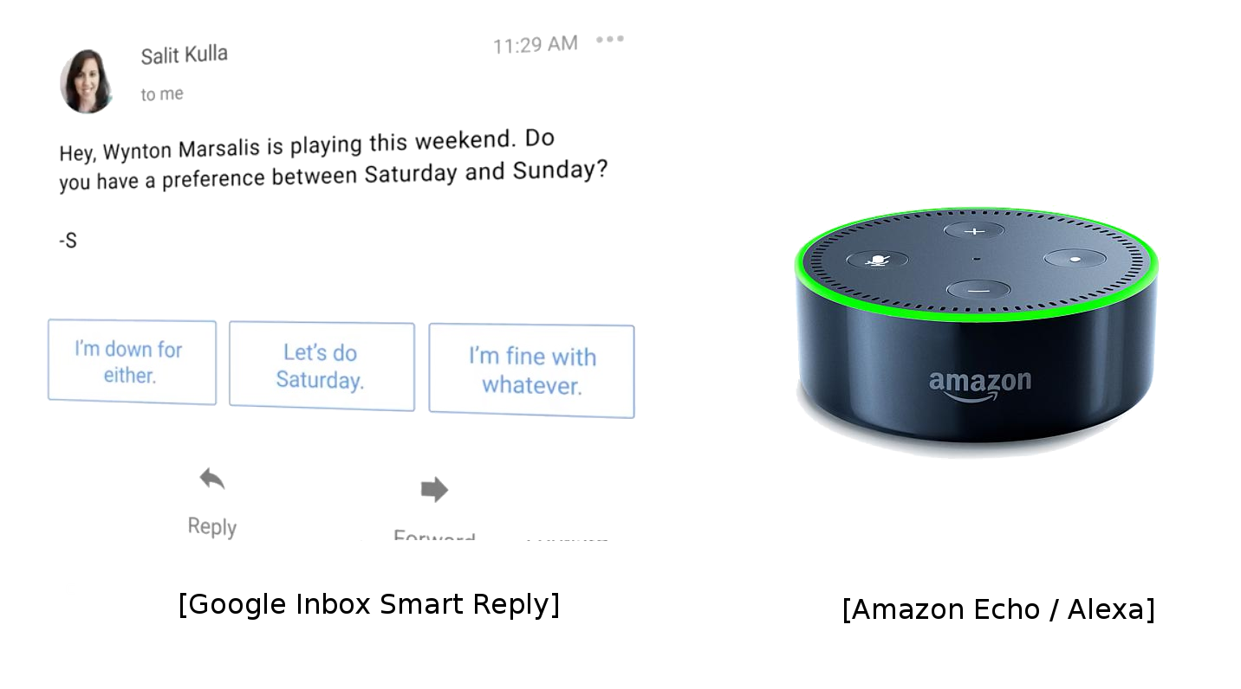
DL Today: NLP
Notes:
In Chat GPT: we have officially fed all NLP data into the model, so now it is very powerful.

Slide 21
DL Today: NLP
Most of chatbots claiming "AI" do not use Deep Learning (yet?)

Slide 22
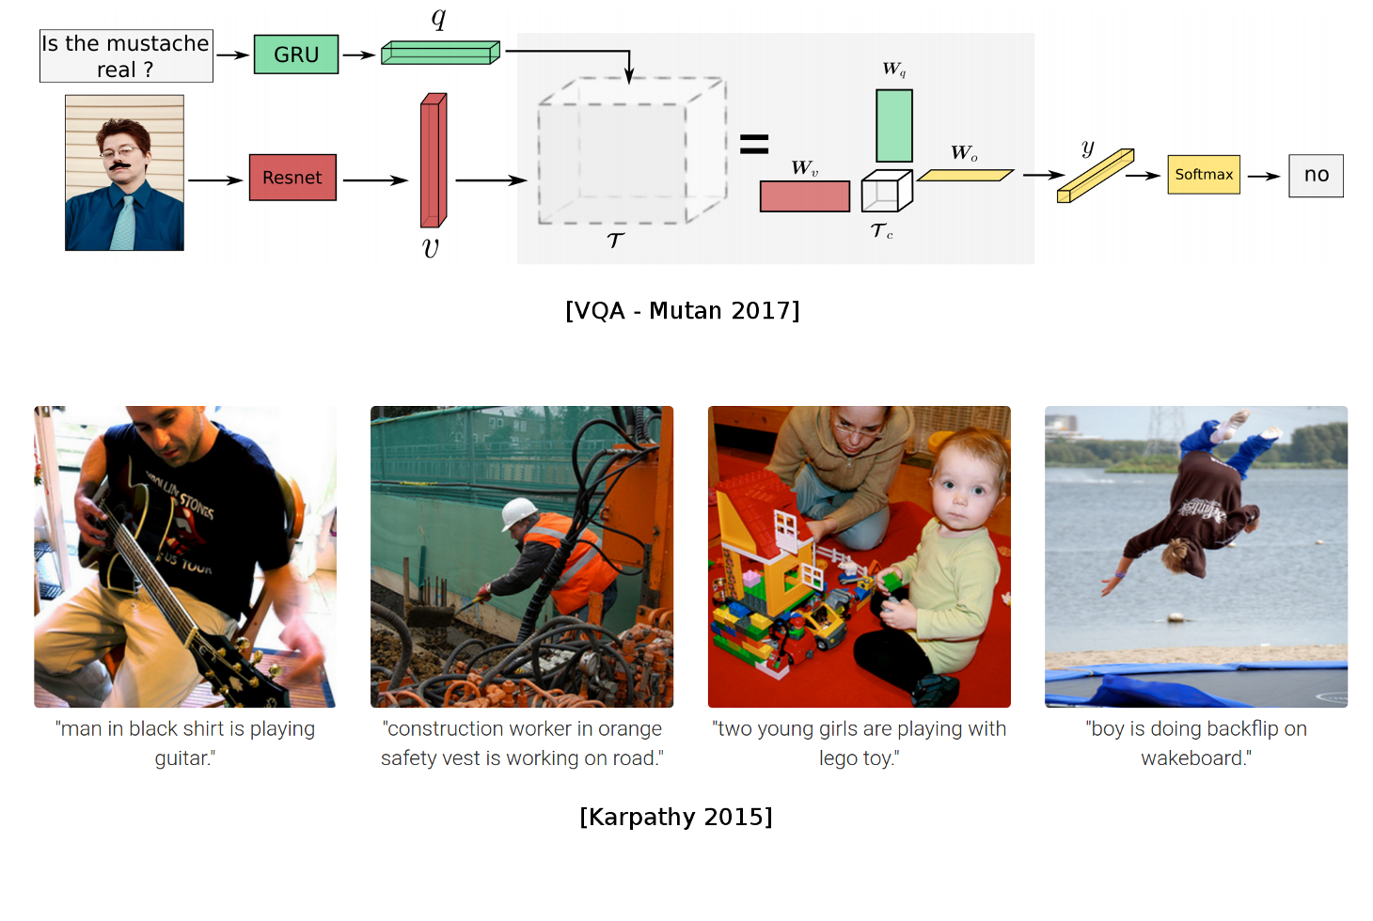
DL Today: Vision + NLP
Notes:
GRU is a RNN model
Resnet is CNN model with 50-101 convolutional blocks.
q and v in the top photo are neural networks (for feature extraction)

Slide 23
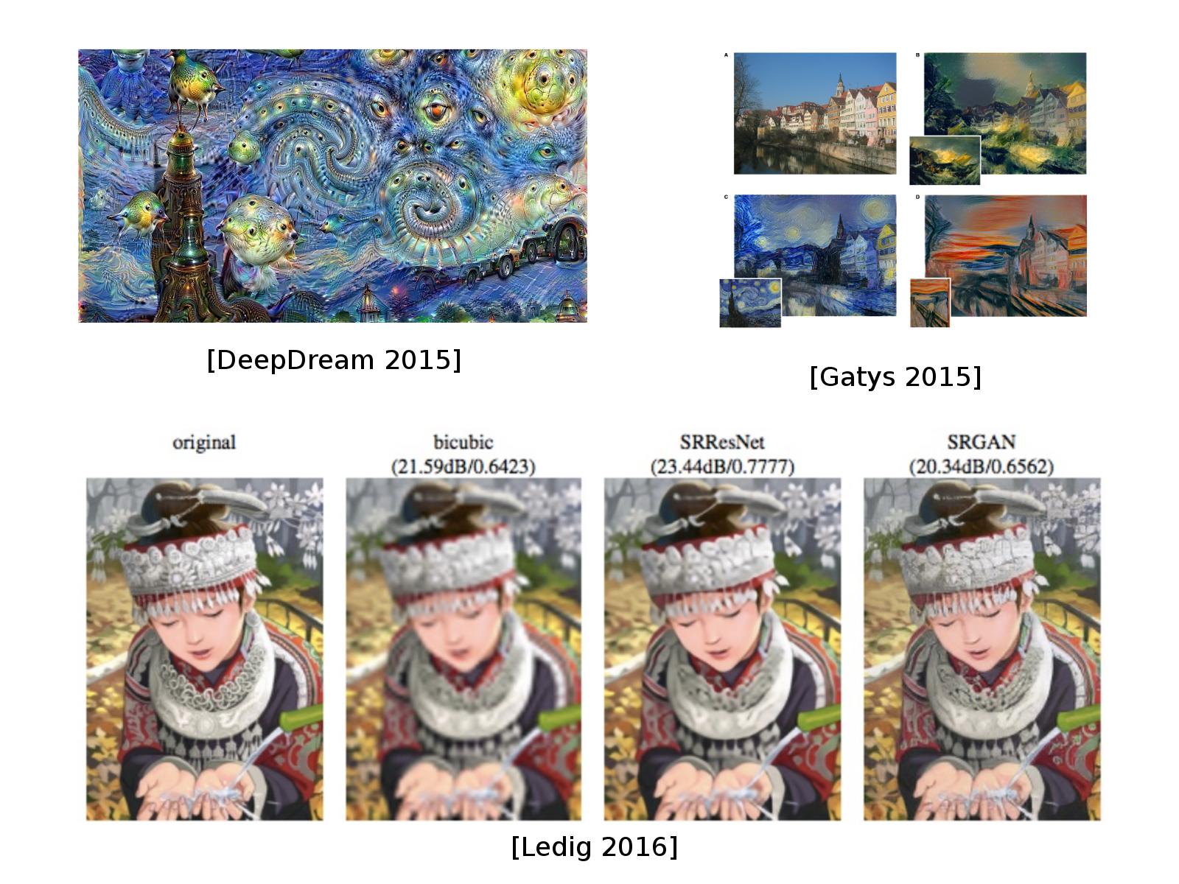
DL Today: Image translation
Notes:
In photoshop, they have Neuro Filter function→ so if you have a low resolution image, you can improve the resolution through this feature because it is a GAN (Generative neural network) which can fill in gaps/impute more pixel into the image while maintaining the image integrity since it only mostly adds data to the already existing data.

Slide 24
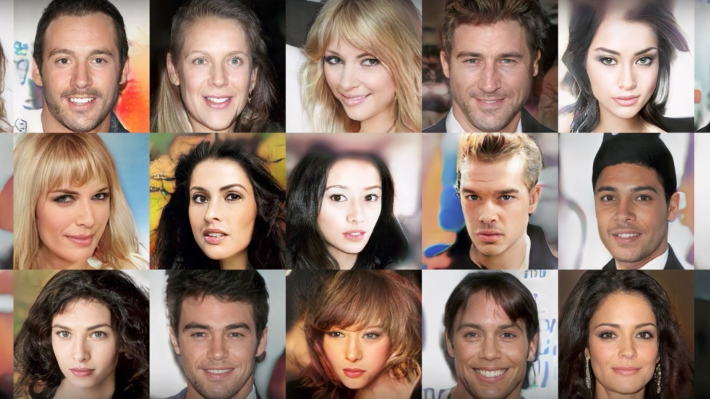
DL Today: Generative models
Sampled celebrities [Nvidia 2017]
Notes:
Above, the generative models can be used to create new work (just like in the last slide).
Another example: use a generative model to create counterfeit money that is so close to the real that it is virtually indistinguishable (cannot reasonable differentiate).

Slide 25
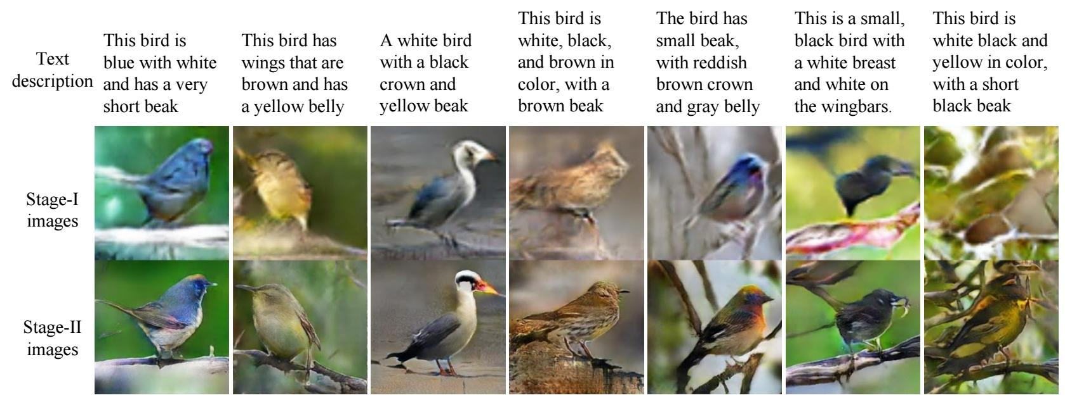
DL Today: Generative models
Sampled celebrities [Nvidia 2017]
StackGAN v2 [Zhang 2017]

Slide 26

DL Today: Generative models

Slide 27

DL Today: Generative models
Guess which one is generated?

Slide 28
DL Today: Generative models
Guess which one is generated?
Tacotron 2 Natural TTS Synthesis by Conditioning WaveNet on Mel Spectrogram Predictions, 2017

Slide 29
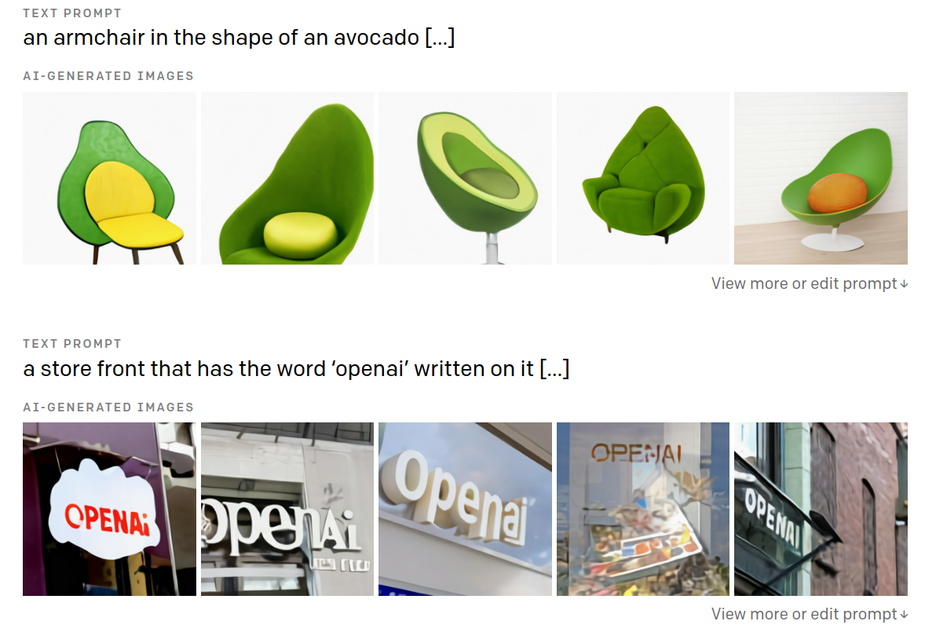
Language / Image models
Open-AI GPT-3, or DALL-E: https://openai.com/blog/dall-e/

Slide 30
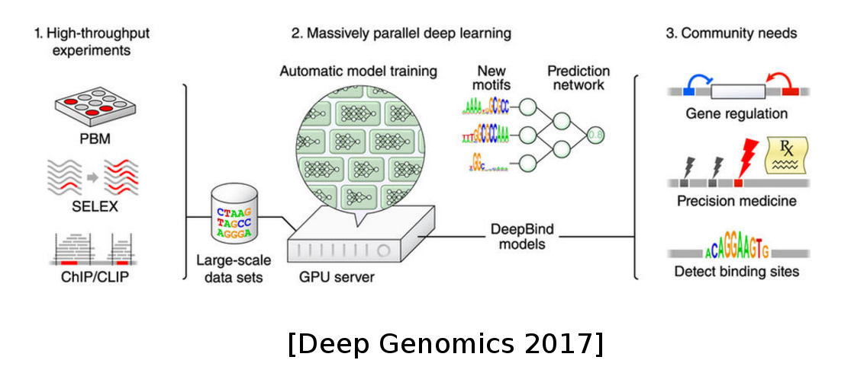
DL in Science: Genomics
DL in Science: Genomics

Slide 31
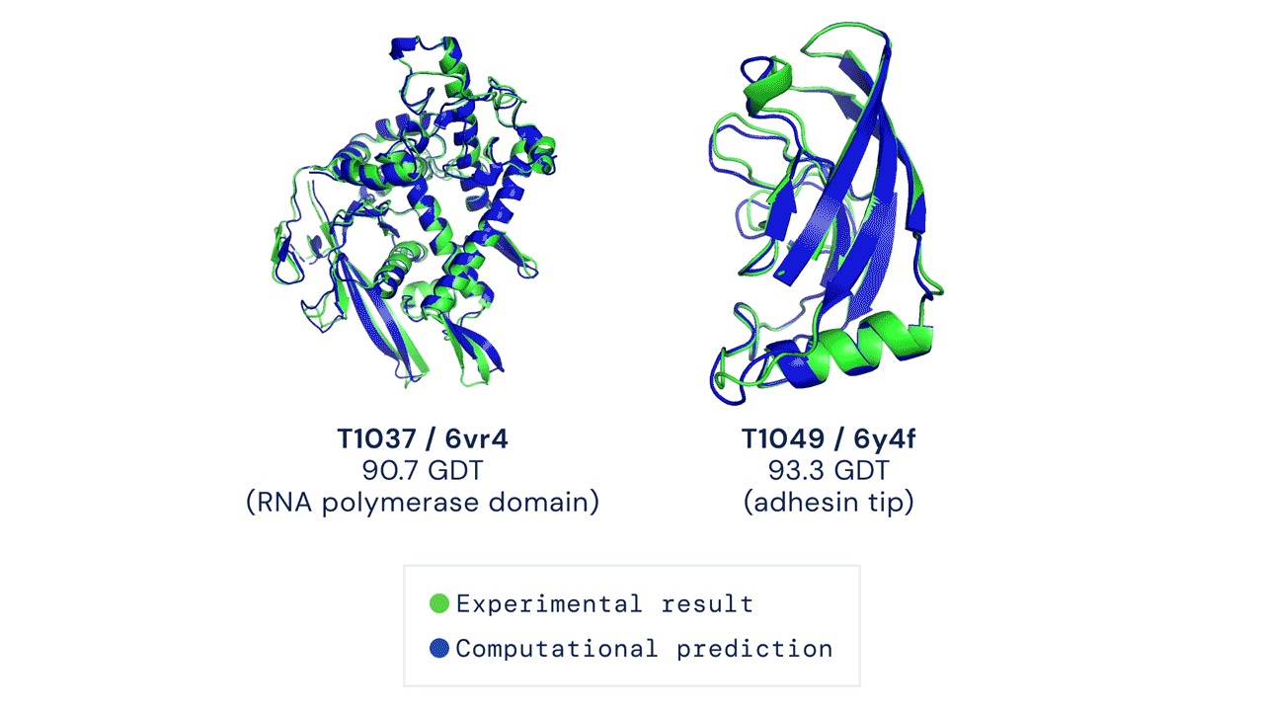
DL in Science: Genomics
DL in Science: Genomics
AlphaFold by DeepMind

Slide 32
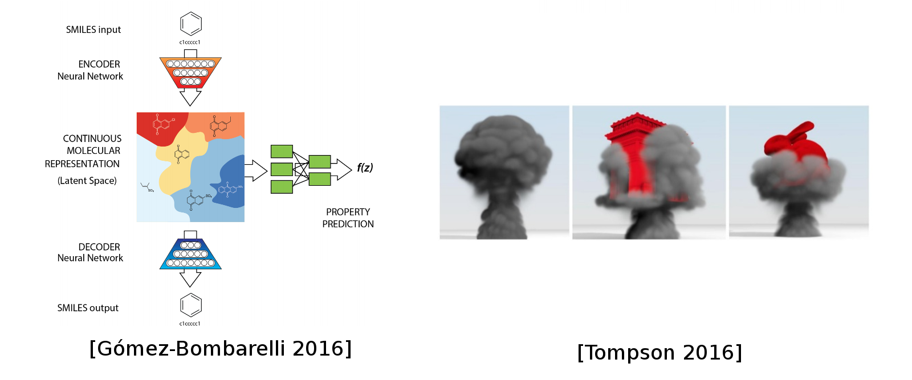
DL in Science: Chemistry, Physics
Notes:
Above: goal is to make a compound that behaves like the input but has some additional features.

Slide 33
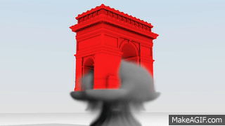
DL in Science: Chemistry, Physics
Finite element simulator accelerated (~100 fold) by a 3D convolutional network
Notes:
Using a deep learning model for physical effects with lower resolution samples to boost them to higher resolution rendering in a simulation.
DLSS → this DLSS feature is inside of COD MW2!!! I have the setting toggled on!

Slide 34
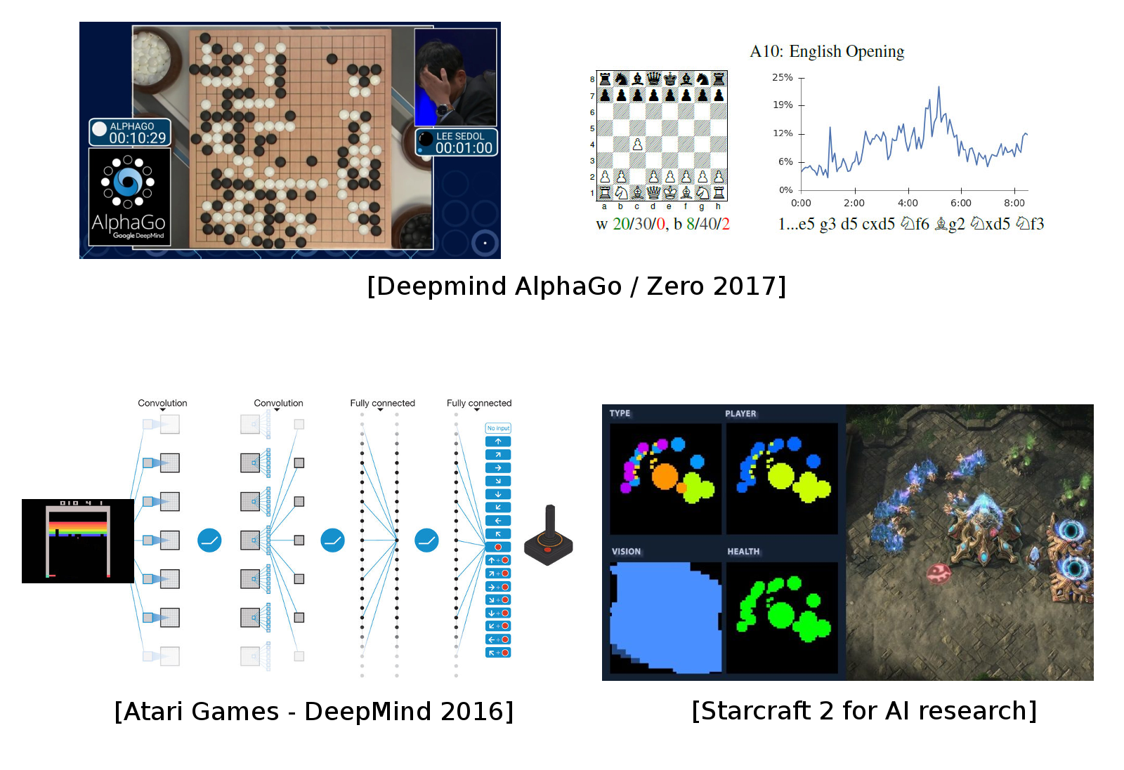
DL for AI in games
Notes:
Deep Q N (DQN) is the backbone for Alpha Go
contains 2 deep neural networks
Humans can use deep learning models that have been well-trained and has high performance and use those models to train themselves to play best strategy particularly when playing against other humans.
Can be applied in military applications.
Think about all of the classified data, huge large BIG DATA that the military possess from on the ground, air, or underwater operations of battles and skirmishes and raids, etc. → now that data is more valuable than ever and can be used to train a model, which can then eventually be used to train real soldiers or plan future operations.

Slide 35
DL for AI in games
AlphaGo/Zero: Monte Carlo Tree Search, Deep Reinforcement Learning, self-play

Slide 36
Outline of the class
1. Backpropagation

Slide 37
Outline of the class
1. Backpropagation
1. Computer Vision (2)

Slide 38
Outline of the class
1. Backpropagation
1. Computer Vision (2)
1. Recommendation Systems

Slide 39
Outline of the class
1. Backpropagation
1. Computer Vision (2)
1. Recommendation Systems
2. Natural Language Processing (2)
Notes:
NLP uses RNN

Slide 40
Outline of the class
1. Backpropagation
1. Computer Vision (2)
1. Recommender Systems
2. Natural Language Processing (2)
2. Optimization: theory, methods and tricks (2) (optional if we have time)

Slide 41
Outline of the class
1. Backpropagation
1. Computer Vision (2)
1. Recommender Systems
2. Natural Language Processing (2)
2. Optimization: theory, methods and tricks (2)
2. Generative models & unsupervised learning
Notes:
Unsupervised learning = no labels like in supervised learning.

Slide 42
Course info
Lectures 2h45m
Run codes on your laptop
Homework weekly or biweekly (finish notebooks, read solutions)
Notes:
Use colab for basic coding in this class (slower, need to pay for GPU usage, otherwise cpu usage is free).
for this class the free version is enough.

Slide 43
Course info
Lectures 2h45m
Run codes on your laptop
Homework weekly or biweekly (finish notebooks, read solutions)
Project: Project of your choice in teams of 2-3 (max) people
Notes:
ICML and ICLR and NeuRIPS, AAAI, IJCAI deep learning top 5 conferences will be the source of the papers for the project.

Slide 44
Recommended reading
deeplearningbook.org: Math and main concepts
Francois Chollet's book: Keras programming
Aurélien Géron's book: Generic Machine Learning with Scikit-learn and Deep Learning with TF/Keras
Notes:
Most companies are not using deep learning as their backbone (I.E. Tesla) because interaction is difficult and often the performance is not measurable because you need data which may not be attainable (i.e. accidents → we cannot purposely allow real accidents to occur from the autonomous system having a failure, or even monetary losses that are not feasible for sacrifice in order to train the model).

Slide 45
Frameworks and Computation Graphs

Slide 46
Libraries & Frameworks
Automatic differentiation: Theano, TensorFlow, MXnet, CNTK

Slide 47
Libraries & Frameworks
Automatic differentiation: Theano, TensorFlow, MXnet, CNTK
Dynamic and high level: TensorFlow 2, PyTorch, Chainer, MinPy, DyNet...

Slide 48
Libraries & Frameworks
Automatic differentiation: Theano, TensorFlow, MXnet, CNTK
Dynamic and high level: TensorFlow 2, PyTorch, Chainer, MinPy, DyNet...
Keras: high level frontend for TensorFlow, MXnet, Theano, CNTK

Slide 49
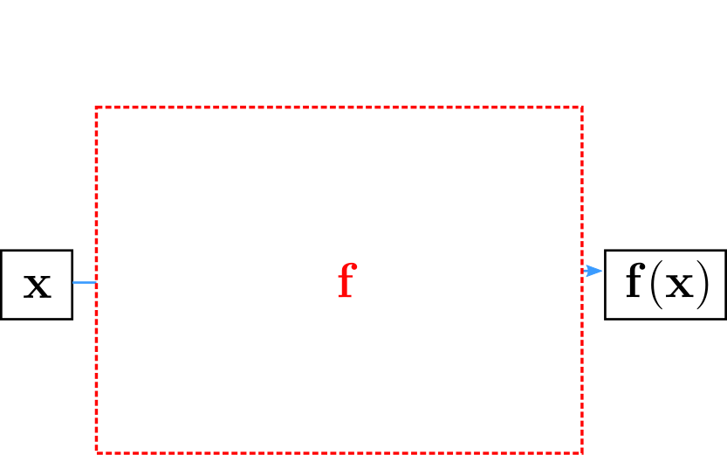
Computation Graph
Neural network = parametrized, non-linear function
Notes:
Remember: must be a nonlinear function because we know if all parameters were linear, then the model is really a simple model that can be combined into one linear function.
Sigmoid function = (e^x/1-e^x) = [output value between 0 and 1] → typically used as the activation function.
Used to give output between 0 and 1 and also is a nonlinear function (which is necessary for neural network)

Slide 50
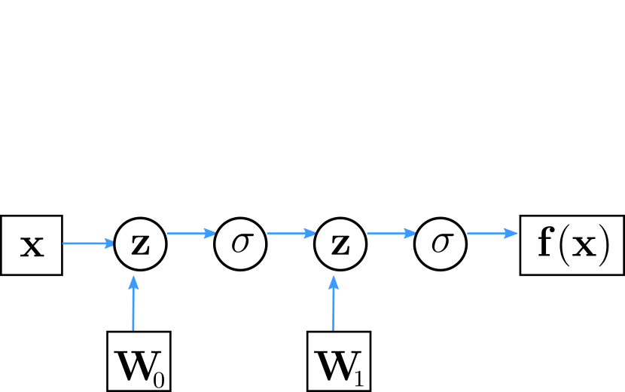
Computation Graph
Computation graph: Directed graph of functions, depending on parameters (neuron weights)
Notes:
Square box nodes= parameter
Round nodes = mathematical operations
Above, each z-sigmoid-w is a single layer of the neural network → so the above shows 2 layers.
Notice with many layers, computation can become very intense/hard to compute.

Slide 51
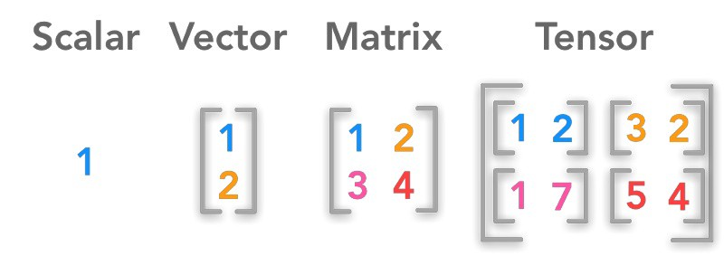

Slide 52
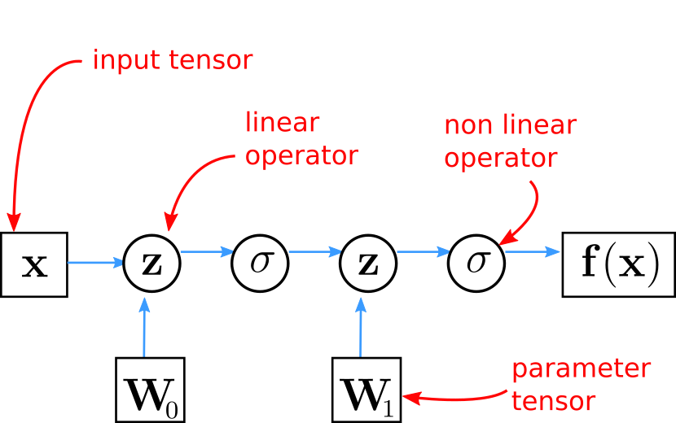
Computation Graph
Combination of linear (parametrized) and non-linear functions
Notes:
Tensor = multi-dimensional array (so basically a matrix)
Typical activation functions: Sigmoid, Tanh, RELU, leakyRELU

Slide 53
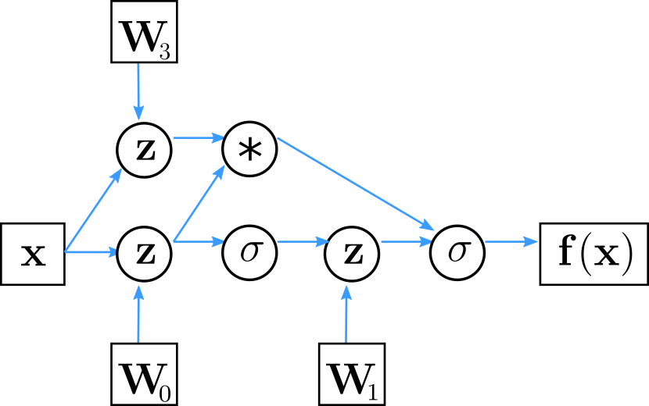
Computation Graph
Not only sequential application of functions
Notes:
Note: some operations can be done in parallel due to the nature of the flow of this computation graph.
Write the above graph as a function for practice.

Slide 54
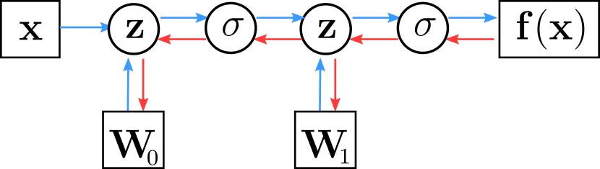
Computation Graph
Automatic computation of gradients: all modules are differentiable!
Notes:
THUS WE CAN DO BACK PROPOGATION.

Slide 55
Computation Graph
Automatic computation of gradients: all modules are differentiable!
Theano (deprecated), Tensorflow 1, etc. build a static computation graph via static declarations.

Slide 56
Computation Graph
Automatic computation of gradients: all modules are differentiable!
Theano (deprecated), Tensorflow 1, etc. build a static computation graph via static declarations.
Tensorflow 2, PyTorch, etc. rely on dynamic differentiable modules: "define-by-run".

Slide 57
Computation Graph
Automatic computation of gradients: all modules are differentiable!
Theano (deprecated), Tensorflow 1, etc. build a static computation graph via static declarations.
Tensorflow 2, PyTorch, etc. rely on dynamic differentiable modules: "define-by-run".
Vector computation on CPU and accelerators (GPU and TPU).

Slide 58
Computation Graph
Simple keras implementation
model = Sequential()
model.add(Dense(H, input_dim=N)) # defines W0
model.add(Activation("tanh"))
model.add(Dense(K)) # defines W1
model.add(Activation("softmax"))
Notes:
X = input vector
W0 and W1 are parameter vectors → Dense() function
Sigma = nonlinear activation functon → Activation() function
Z = linear operation

Slide 59
Computation Graph
Simple keras implementation
model = Sequential()
model.add(Dense(H, input_dim=N)) # defines W0
model.add(Activation("tanh"))
model.add(Dense(K)) # defines W1
model.add(Activation("softmax"))

Slide 60
Recommended reading
deeplearningbook.org: Math and main concepts
Francois Chollet's book: Keras programming
Aurélien Géron's book: Generic Machine Learning with Scikit-learn and Deep Learning with TF/Keras

